Slide 1
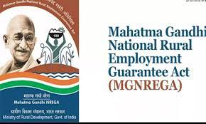
NREGA (National Rural Employment Guarantee Act)
NREGA is a transformative government scheme aimed at providing rural households with guaranteed
wage employment opportunities.

Slide 2
Overview
The dataset used for this analysis encompasses a wide range of parameters, including the number of job cards issued, the workforce engaged, budget allocation, work completion statistics, and much more. Through the application of data analytics techniques, we aim to gain valuable insights into the implementation and impact of NREGA across different states and districts in India.
Problem Statement:
NREGA is a vital initiative to alleviate rural unemployment and poverty. This project seeks to address several key questions and challenges associated with NREGA:
How effective is NREGA in providing employment opportunities to rural households?
Are there regional disparities in the implementation and outcomes of the scheme?
What is the utilization of the allocated budget, and how does it correlate with employment generation?
What are the key factors contributing to the completion of NREGA works, and are there any roadblocks to its success?
Can data-driven insights guide policymakers and administrators in optimizing the scheme's impact?

Slide 3
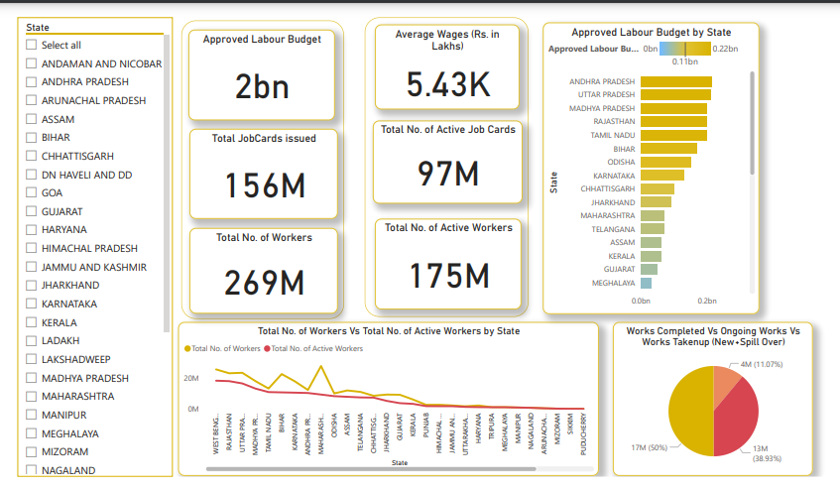
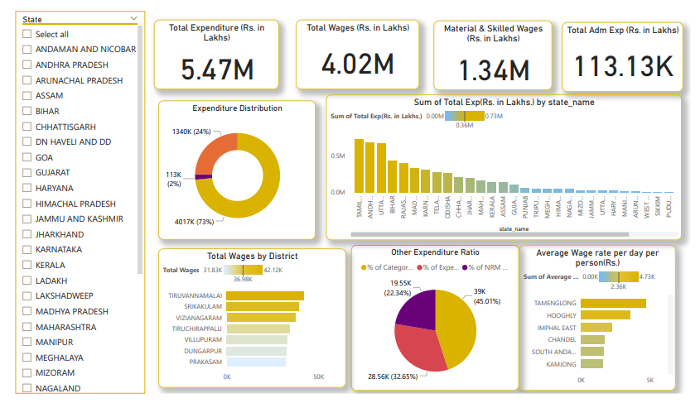
Dashboard
The dataset used for this analysis is sourced from official government records and contains information
related to NREGA implementation across various states and districts in India. It comprises 28 columns,
encompassing data on job cards, worker details, budget allocation, work completion statistics,
expenditure, and more. This dataset offers a comprehensive view of the progress and challenges faced
by the NREGA program.
Overview
Expenditure

Slide 4
Analysis and Insights
Total Approved budget: 5 Billion
Total Jobcards issued: 156 M and Total No. of Active Job Cards: 97 M
Total No. of Workers: 269 M and Total No. of Active Workers:175 M
Andhra Pradesh, Uttar Pradesh, Madhya Pradesh, Rajasthan, Tamil Nadu, these are the top 5 states with highest approved budget
Maharashtra, West Bengal, Uttar Pradesh, Bihar, these are the top 5 states with highest No. of Workers and In term of Active Workers, West Bengal, Rajasthan, UP, Madhya Pradesh, & Tamil Nadu has most number of active workers.
Work Completion Ratio: 50% of works has Takenup, 38.95% is Ongoing and 11.07% is Completed

Slide 5
Total Expenditure: 5.47 M
Total Wages:4.02 M (73.44%), Material & Skilled Wages: 1.34 M (24.49%) and Total administrative Expenses: 113 K (2%)
Tamil Nadu, Andhra Pradesh, Uttar Pradesh, Bihar, Rajasthan, these are the top 5 states having maximum expenditure

Slide 6
Tamil Nadu has 27.41% work completed, approved labor budget 200 M, Total No. of Workers (13 M, 11M)
Tripura has 16.93% of work completed, 25 M labor budget, workers (1M, 1M)
Chhattisgarh has 16.44 of work completed, 100 M labor budget, workers (9M, 7M)
Above points shows that yes budget play role in work completion ratio as well as number of active work contribute a lot whether the work is completed, ongoing or takenup

Slide 7
Conclusion
The vision of Mahatma Gandhi NREGA is to enhance the livelihood security of rural households across the country by providing at least 100 days of guaranteed wage employment in a financial year to every rural household whose adult members volunteer to do unskilled manual work. Mahatma Gandhi NREGA recognizes the importance of strengthening the livelihood resource base of the poor by reaching the most vulnerable sections of rural areas, including Scheduled Castes, Scheduled Tribes, women-headed households, and other marginalized groups.
The scheme encourages a sense of community and collective responsibility by strengthening Panchayat Raj institutions. Mahatma Gandhi NREGA promotes a bottom-up approach to planning and execution, empowering local communities to take charge of their development. Through the creation of productive assets of prescribed quality and durability, the scheme addresses immediate economic needs while laying the foundation for long-term prosperity.
Mahatma Gandhi NREGA prioritizes sustainable development and environmental stewardship, striving to create a greener, more sustainable future for generations to come by prioritizing works that contribute to ecological conservation and rural infrastructure development. Central to the scheme's vision is a commitment to transparency and accountability, ensuring that funds are utilized efficiently and beneficiaries' rights are upheld through mechanisms such as social audits, grievance redressal, and proactive public disclosure.

